Slide 1


Basic E-Voting System
NBKR INSTITUTE OF SCIENCE AND TECHNOLOGY
CSE - E Section
1st year, II-sem
TEAM MEMBERS:
S.YASASWINI- 24kb1a05kb
U.PALLAVI- 24kb1a05lw
T.LAHARI-24kb1a05ku
TANUSHREE-24kb1a05kq
GUIDED BY: ASHOK SELVAN SIR

Slide 2

Overview
Introduction
Objective
Why c and DSA (Data Structures and Algorithms)
Algorithm
Lesson learnt
Code
Output

Slide 3
Introduction
Voting is an essential part of democracy. Traditionally, voting is done manually, which is time-consuming and prone to human errors .
This project aims to build a Basic E-Voting System using the C programming language and Data Structures to make the voting process simple, fast, and secure (one person, one vote).

Slide 4

Register candidates for an election . Allow users (voters) to cast a vote only once . Prevent multiple voting by the same voter . Count the votes for each candidate . Declare the candidate with the highest votes as the winner . Understand how basic Data Structures and modular programming can solve real-world problems.
Objective
This Photo by Unknown Author is licensed under CC BY

Slide 5
WHY C LANGUAGE& DSA?
C Language is fast, close to hardware, and helps understand the memory and logic behind a system.
Data Structures (Arrays, Structs) allow organized storage and management of information (Candidates, Voters).
Algorithms provide a systematic method to solve the problem efficiently.
Using C and DSA together gives better control over how data is processed, saved, and retrieved, making the system reliable and efficient

Slide 6
Algorithm
Step 1: Initialize the Voting System - Set candidate count and voter count to 0.
Step 2: Register Candidates - Input candidate names. Assign each candidate a unique ID.
Step 3: Voter Voting - Input voter ID. Check if voter has already voted using the voter list. If not voted: Display candidates. Record the vote for the selected candidate. Add the voter ID to prevent multiple votes.
Step 4: Counting Votes - Display the vote count for each candidate.
Step 5: Declaring Winner - Find the candidate with the maximum votes. Display the winner's name and total votes.
Step 6: Exit the system.

Slide 7
LESSON LEARNT
Learnt Practical use of Structures and Arrays to store data.
How to build a simple real-world application using C.
Importance of validation (like preventing double voting).
Using modular programming (functions) to make the code clean and understandable.
Basics of searching and counting algorithms

Slide 8
Code
https://onlinegdb.com/2tqz-7IjN

Slide 9
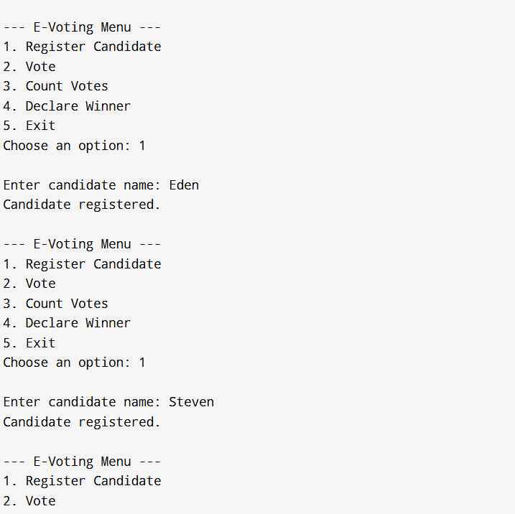
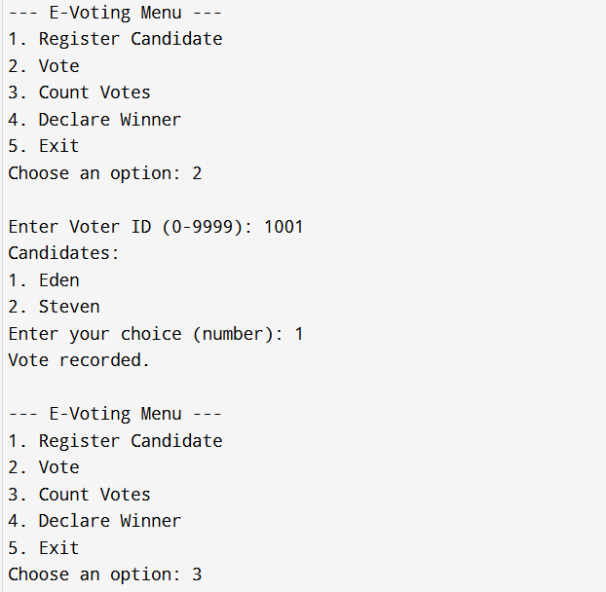
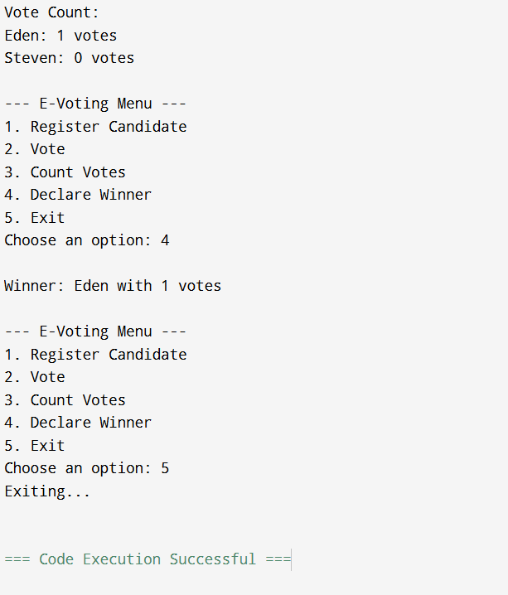
Output

Slide 10

Summary
This project shows how basic concepts of C programming, structures, arrays, and simple algorithms can be combined to build a working E-Voting System.

Slide 11
Thank You

